Slide 1





Introduction to Classical Statistics
Unlike Bayesian case, is not a conditional PDF.
Unlike Bayesian case, there is no “prior” on
contains all unknown (deterministic) parameters
contains all N measurements
“Estimator” processes the measurements to approximate

Slide 2
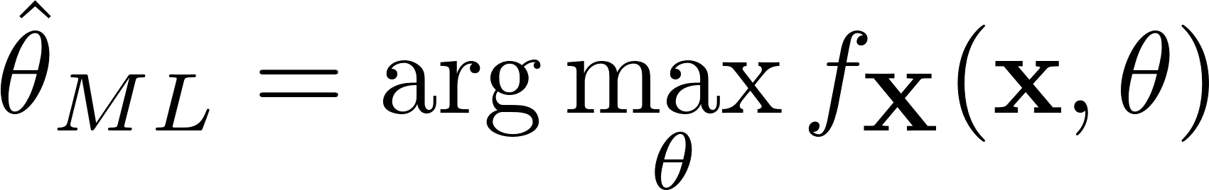


Maximum Likelihood Estimation
Model is described by how unknown depends on the PDF
Pick the parameter that makes the data “most likely”
“argmax” means the value of that maximizes
Clearly it is a function of
Plug in the random observation observation for
The result from argmax yields a function of which is random

Slide 3




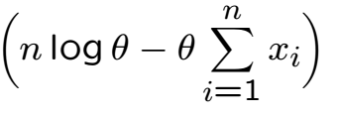

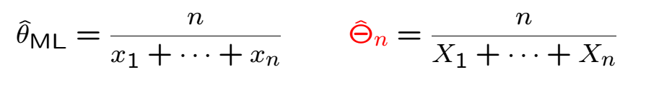
Example

Slide 4
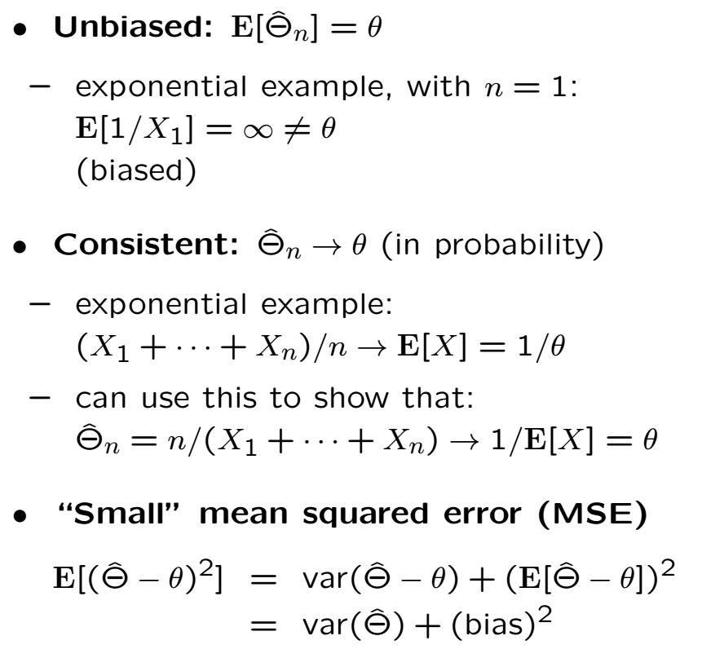
Good Estimators

Slide 6
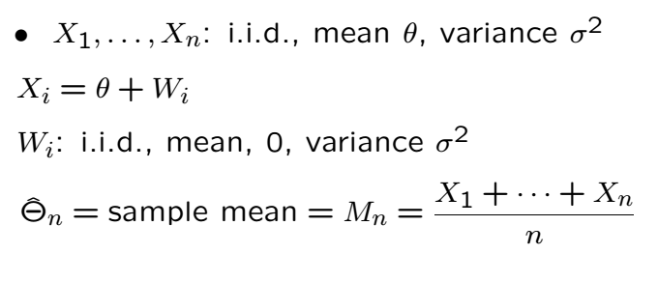
Example: Estimating the Expectation

Slide 8
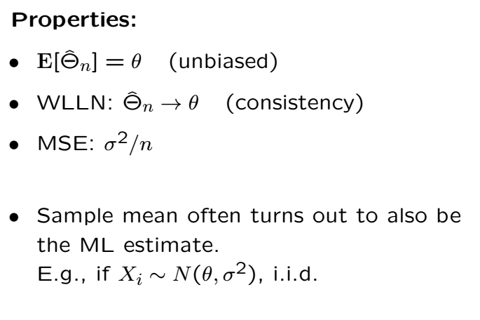
Properties of the “Sample Mean”

Slide 9
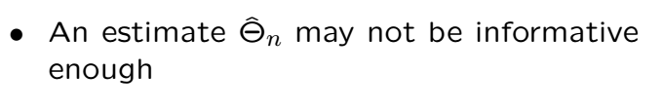
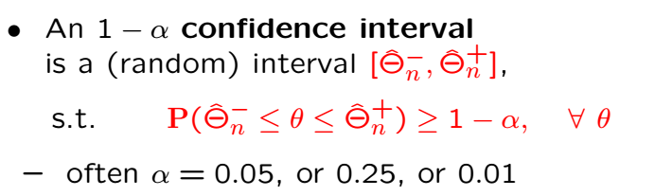
Confidence Intervals, or Interval Estimation
Instead of producing one value as an estimator,
we produce an interval based on observation

Slide 10

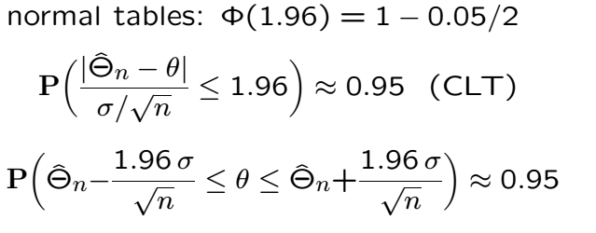
Example
True even if data are not Gaussian due to CLT

Slide 12
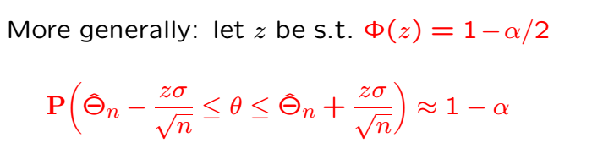
Example Cont’
What happens to the interval as n gets larger?

Slide 13
Acknowledgements and Citations
Parts of these slides are adapted from the following resources:
Power Point Lecture Slides for the Textbook http://bcs.wiley.com/hebcs/Books?action=index&bcsId=8676&itemId=1118324560
John Tsitsiklis. 6.041 Probabilistic Systems Analysis and Applied Probability, Fall 2010. (Massachusetts Institute of Technology: MIT OpenCourseWare),http://ocw.mit.edu (Accessed 13 Apr, 2015). License: Creative Commons BY-NC-SA

